Slide 1
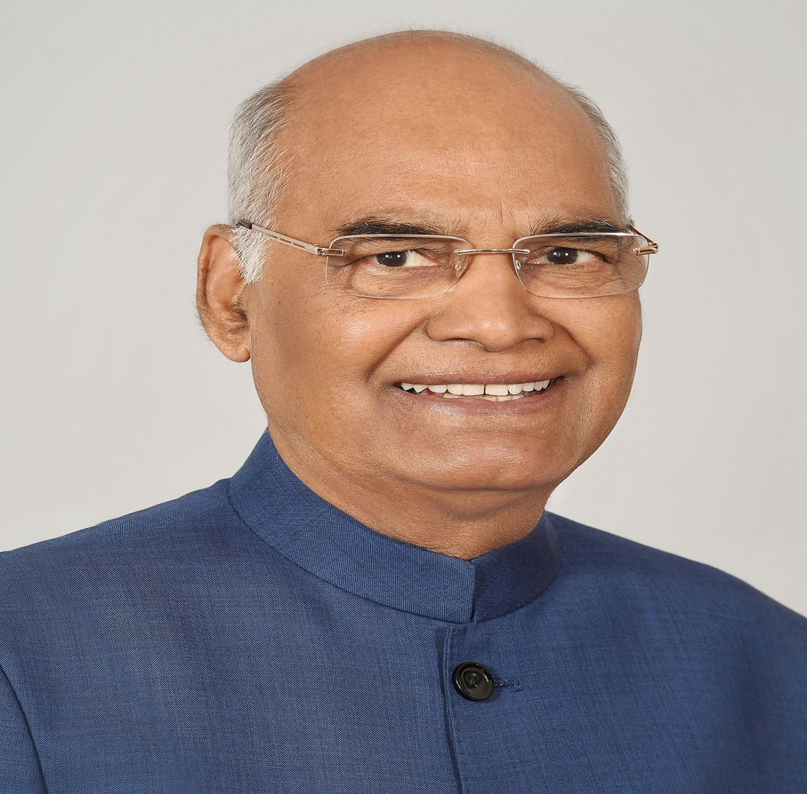
PRESIDENT OF INDIA
MR. RAMNATH GOVIND

Slide 2
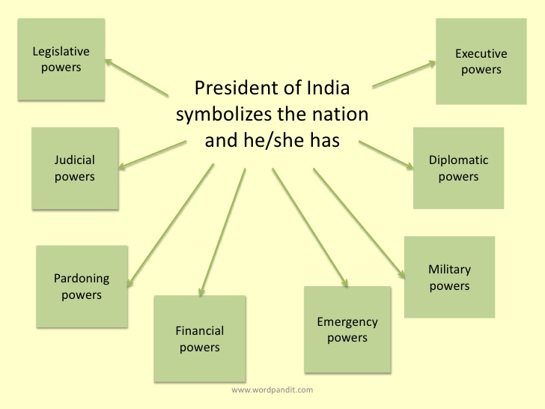

Slide 3
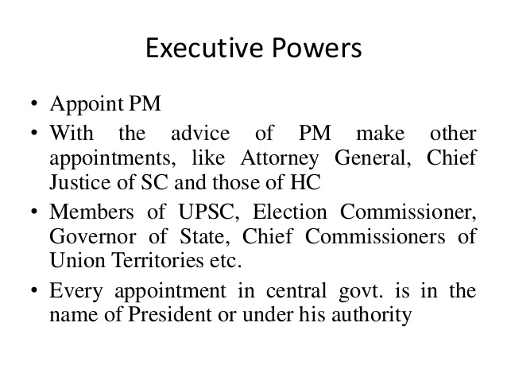

Slide 8
PREPARED BY
KALYANI S

